Slide 1
SCRAPING CATERPILLAR
Bruna Ferreira Santos

Slide 2
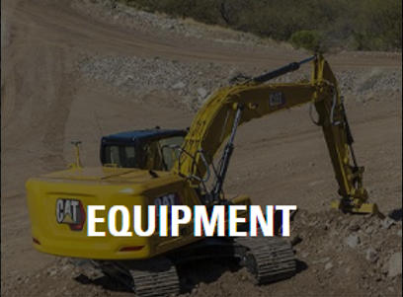
The Project :
Collect the information available on the Caterpillar website on its proposed equipment.

Slide 3
The Process:
Knowing your website and how to scrap it.
Collect the data and exploring it
Cleaning the data and organizing it.

Slide 4
Challenges:
Collect the data of all 25 models of equipment.
Understand and organize the data.
A lot of missing values.

Slide 5
ANOTHER WAY
Try to scrap the page of each equipment id to collect all the information about the equipment type.

Slide 6
Improvements:
Try to get a better data from Caterpillar.
Try to collect the equipment data from others companies.
and compare the market.
Organize better my work.

Slide 7
Higlights:
Better understanding of web scraping
Practice of python and a better assimilate of the technique
Managing frustration

Slide 8
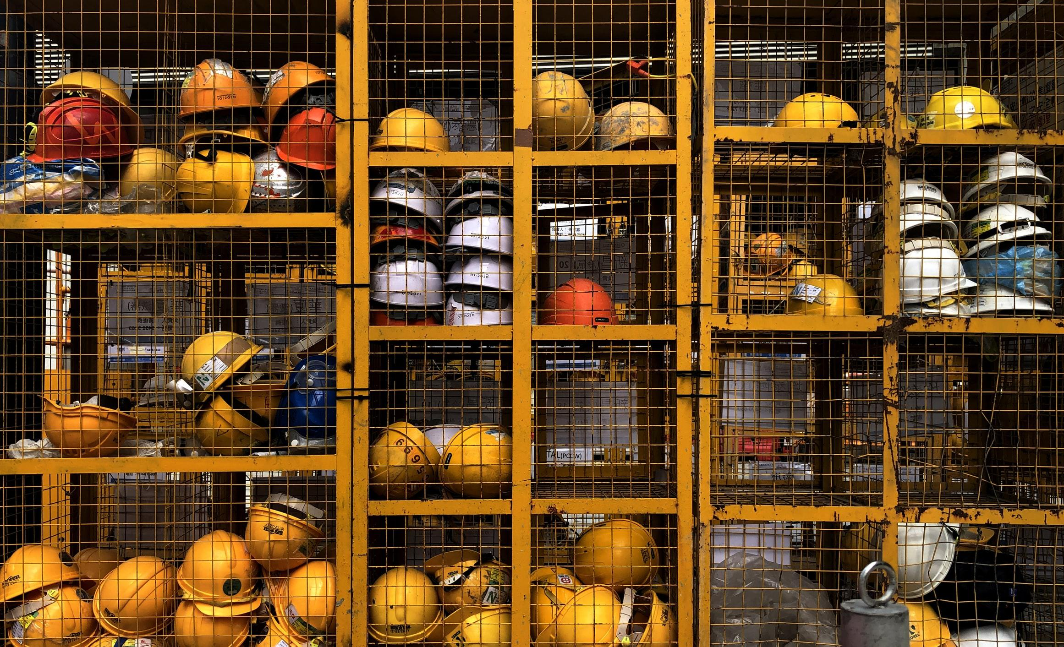
Thank you

